Slide 1

Build, secure and manage Serverless Applications at scale on AWS
Ayanda Tshabalala
Associate Cloud Transformation Consultant

Slide 2


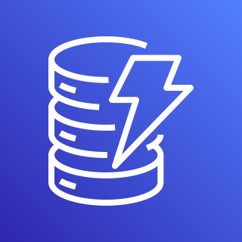
Building an Order API by using the AWS Serverless Stack
What to expect in this workshop
Introduction to AWS SAM
Quick overview of AWS services used
Workshop Guide
Key Takeaways
API Gateway
Lambda
DynamoDB

Slide 3



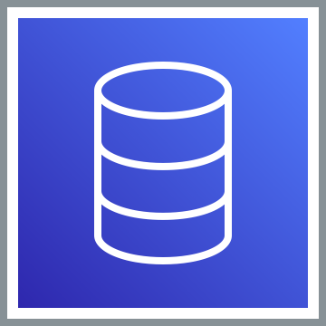

What to expect in this workshop
Compute
Security, Identity, & Compliance
Amazon Cognito
AWS Lambda
Database
Application Integration
Amazon DynamoDB
Amazon SQS
AWS Step Functions
Amazon API Gateway
Notes:
In this workshop you are going to create an ordering service, for example you are using your uber eats app and you are ordering pizza, you will need to login to app right(That is where amazon Cognito will come in) after that place an order(With the help of Amazon gateway) to pass that information to be read by compute system and rearrange it nicely and store it on your database(Amazon DynamoDB) this whole application is serverless because you do not have to know how to provision or measure these services you just in simple terms connecting them to create a working application

Slide 4
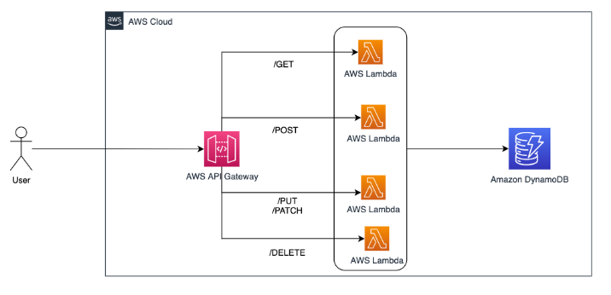
What to expect in this workshop
Notes:
In this workshop you are going to create an ordering service, for example you are using your uber eats app and you are ordering pizza, you will need to login to app right(That is where amazon Cognito will come in) after that place an order(With the help of Amazon gateway) to pass that information to be read by compute system and rearrange it nicely and store it on your database(Amazon DynamoDB) this whole application is serverless because you do not have to know how to provision or measure these services you just in simple terms connecting them to create a working application

Slide 5
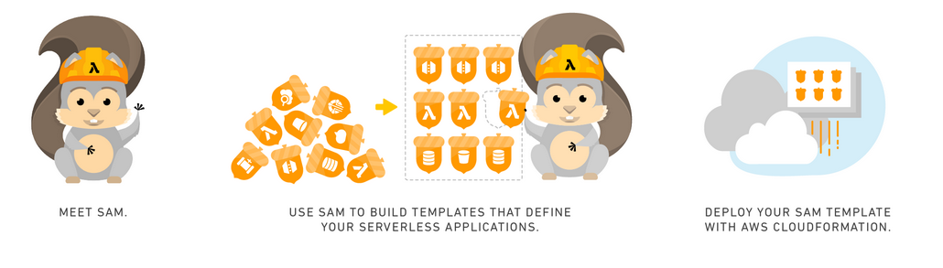
What is the AWS Serverless Application Model (SAM) ?
Notes:
To create a serverless application using AWS SAM, create a SAM template: a JSON or YAML configuration file that describes your Lambda functions, API endpoints, and the other resources in your application. You can then test, upload, and deploy your application using SAM CLI
When you go through the lab you will get to understand what SAM CLI is

Slide 6
Quick overview of AWS services used
A Key-value and document database
It is for our order service to store our orders
Amazon DynamoDB

Slide 7
Quick overview of AWS services used
Handles all the tasks involved in accepting and processing up to hundreds of thousands of concurrent API calls
APIs act as the "front door" for applications/resources to access data, functionality from your backend services
Amazon API Gateway

Slide 8
AWS Lambda
Quick overview of AWS services used
A serverless compute service that lets you run code without provisioning or managing servers.
From the end users requests through API Gateway, AWS Lambda will pass that request to the Database in a sorted way

Slide 9

Quick overview of AWS services used
A fully managed message queuing service that enables you to decouple serverless applications.
It will help with storing request messages from the end user to manage load on database
Amazon Simple Queue Service (SQS)
Notes:
Maybe here there are many people using your app causing too much load on the Database, use SQS to que the requests

Slide 10

Quick overview of AWS services used
A low-code visual workflow service used to build serverless applications
For order management it enforces which steps your application should follow to validate everything before proceeding
AWS Step Functions
Notes:
Like on the food app, you provide a payment method and getting the validation from the restaurant if what you are ordering is available before everything is finalised

Slide 11

Quick overview of AWS services used
Lets you add end user sign-up, sign-in, and access control to your web and mobile apps quickly and easily
To secure our application so that the end users or API developers who want to reach the API will first need to get ID token from Cognito by using their Cognito credentials(username/password/client id/client secret)
Amazon Cognito

Slide 12
Workshop Guide
Pre-requisites
Skip …on your own
Note: Shared Build,Secure_and_Manage_Serverless_Applications_at_Scale_on_AWS_lab.pdf follow the Notes I have add on a note section
Note : If you are getting and error check you indentation
https://catalog.us-east-1.prod.workshops.aws/workshops/b34eab03-4ebe-46c1-bc63-cd2d975d8ad4/en-US

Slide 13
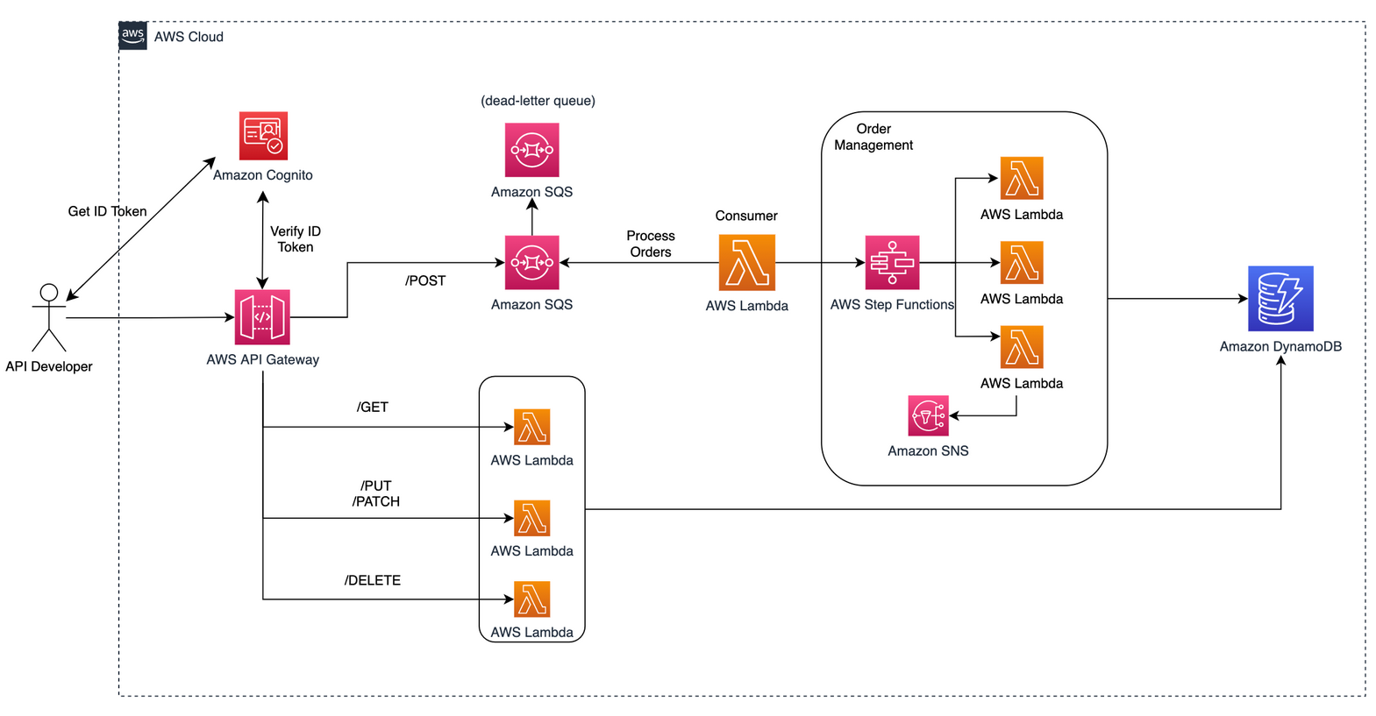
Key takeaways
You can focus more on building than managing your resources and save time
The serverless application looks like the architecture below, where users of your application can list their orders, create new orders, show order details, update order status and cancel the order.
Notes:
Use the following code snippet instead of the one provided on the workshop

Slide 14
Next Steps
Follow the link below to build a Serverless Web Application manually without SAM
https://aws.amazon.com/getting-started/hands-on/build-serverless-web-app-lambda-apigateway-s3-dynamodb-cognito/module-3/

